Slide 1
Flipkart Customer Service Analysis for Retention Improvement
The problem statement tells us that "The goal is to identify specific issues within customer service operations that may be affecting customer satisfaction and retention rates". So, we will focus only on the customer service aspect of customer retention.
We’re only looking at customer service-related issues for retention, even though other factors could also impact retention.
Our job is to help keep more customers coming back to Flipkart by looking closely at how customer service works. To do this, we’ll look at the different steps a customer goes through when they reach out for support while trying to buy a product.

Slide 2
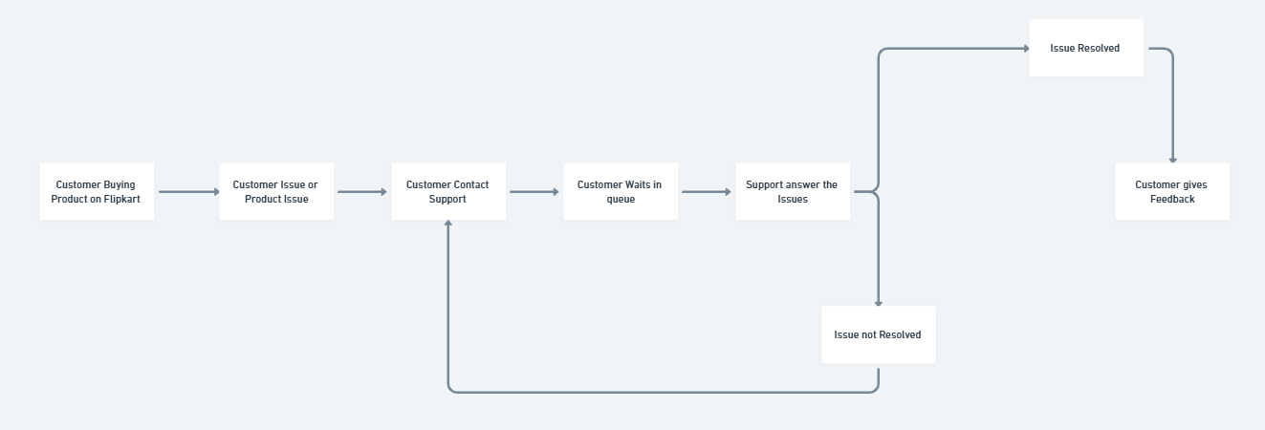
User Journey Map

Slide 3
User Journey Map
Customer Support Journey
Customer Buying a Product: The process begins when a customer is purchasing a product on Flipkart.
Issue Arises: The customer encounters a problem, either with the product itself or with the purchasing experience.
Customer Contacts Support: To address the issue, the customer reaches out to Flipkart's customer support team.
Waiting in Queue: After contacting support, the customer may need to wait in a queue until a representative is available
Support Provides Assistance: A support agent assists the customer, aiming to resolve the issue.
Resolution Outcome:
If the issue is resolved, the customer moves forward to give feedback.
If the issue is not resolved, the customer may need to reach out again or escalate the matter.
Feedback: When the issue is resolved, the customer gives feedback on their experience, which can provide insights into service quality and areas for improvement.

Slide 4
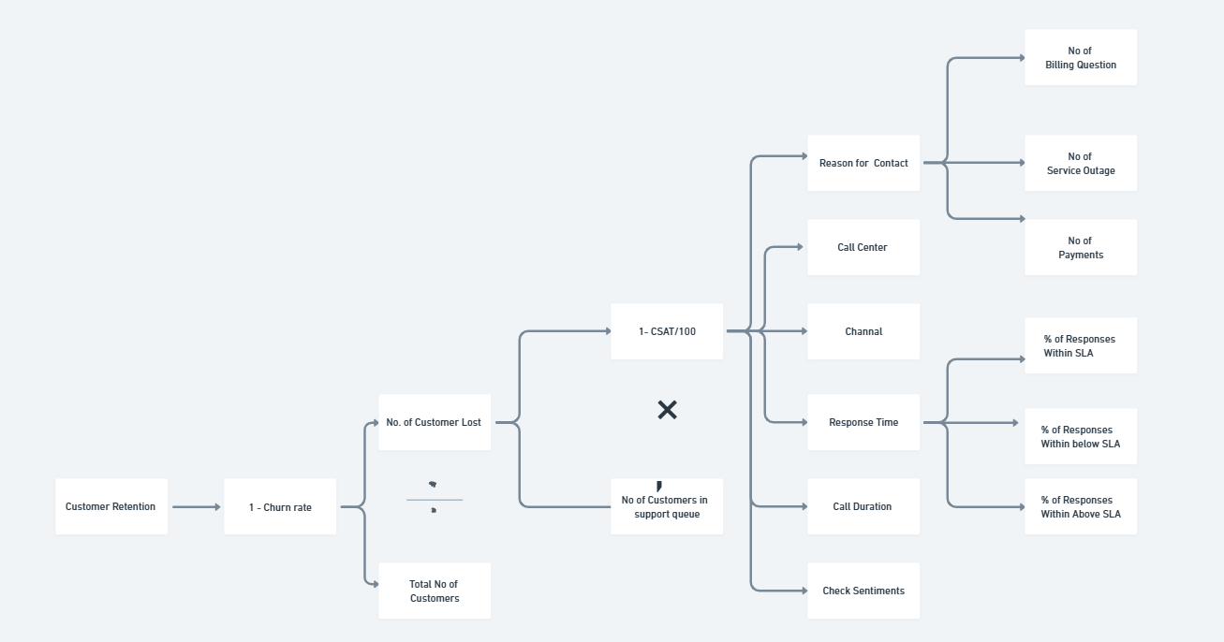
Metric Tree

Slide 5
Details on Metric Tree
Customer Retention:
Customer retention is calculated as (1−Churn Rate)(1 - \text{Churn Rate})(1−Churn Rate). Churn rate is the percentage of customers who leave our platform due to poor experiences or other factors.
Churn Rate Calculation:
The churn rate is calculated by dividing the number of customers lost by the total number of customers.
Focus on Number of Customers Lost:
Since we’re focusing on customer service operations, we’ll concentrate on the number of customers lost.
Measuring Bad Experience:
A bad customer experience can lead to customers leaving the platform. While we can’t directly measure bad experiences, we use the Customer Satisfaction Score (CSAT) as a proxy. CSAT scores range from 0 to 100.
Impact of CSAT on Customer Loss:
Customer loss is estimated using CSAT, where higher CSAT means fewer losses. The formula is:

Slide 6
Defining Key Metric
CSAT Score: Measures how satisfied customers are with the support they receive.
Percentage of Responses Within SLA: Shows the percentage of customer support responses that meet the Service Level Agreement (SLA) time limits.
Reason for Contact: Identifies the primary issues or inquiries that prompt customers to reach out to customer support.
Contact Center Metrics: Evaluates the performance of different customer support centers to ensure consistent and efficient service across locations.
Duration to Resolve Issues:Tracks how quickly customer issues are resolved.
Percentage of Issues Resolved in One Contact: Indicates the percentage of customer issues that are resolved during the first contact with support.

Slide 7
Listing Hypothesis
Hypothesis 1: Certain call center have consistently lower CSAT scores compared to others.
Hypothesis 1.2: Call centers with longer response times tend to have lower CSAT scores.
Hypothesis 2 :Issues that occur more frequently, such as billing-related questions, are likely a primary reason for lower customer satisfaction scores.
Hypothesis 3: The CSAT scores differ based on whether responses were within, below, or above the SLA.
Hypothesis 4: Certain dates have a much higher number of reported issues, which affects CSAT scores.
Hypothesis 4.1: The day of the week affects the customer satisfaction (CSAT) score
Hypothesis 5: Certain support channels (like phone, chat, or email) are better at solving issues, resulting in higher CSAT scores.
Hypothesis 6: Higher Issue Count Correlates with Lower Customer Satisfaction (CSAT) Scores Across Locations

Slide 8
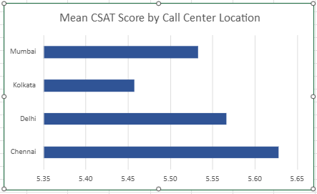
Hypothesis-Driven Data Insights
Hypothesis 1: Certain call center have consistently lower CSAT scores compared to others.
Outcome - The analysis supports Hypothesis 1, as Kolkata consistently shows a lower CSAT score compared to other locations.
Analysis - Kolkata has the lowest mean CSAT score at 5.46, which may negatively impact customer retention. In contrast, Chennai, with the highest score of 5.63, is likely to have stronger customer satisfaction.

Slide 9
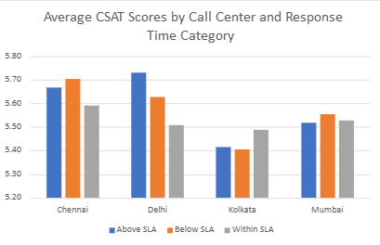
Hypothesis 1.2: Call centers with longer response times tend to have lower CSAT scores.
Outcome - There is no significant variation in CSAT scores based on response time. Kolkata consistently underperforms across all three categories.
Analysis - A table was used to compare CSAT scores with response times labeled as "Above SLA," "Below SLA," and "Within SLA." The findings show that there is no noticeable difference in CSAT scores based on these response time categories.

Slide 10
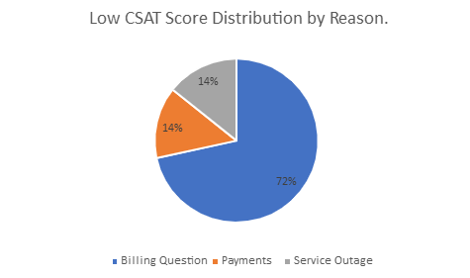
Hypothesis 2 :Issues that occur more frequently, such as billing-related questions, are likely a primary reason for lower customer satisfaction scores.
Outcome - "Billing-related issues are the most frequent and lead to the highest customer dissatisfaction, comprising 72% of cases with CSAT scores less than or equal to 5. This indicates billing questions as a primary factor in reduced customer satisfaction."
Analysis -To understand low CSAT's impact on customer retention, we first counted the occurrences of each reason for low scores and then converted these counts to percentages. Billing Questions emerged as the top reason, accounting for 72% of low CSAT scores, followed by Service Outages at 15% and Payments at 13%, indicating that addressing these issues could improve retention.

Slide 11
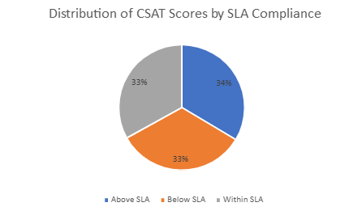
Hypothesis 3: The CSAT scores differ based on whether responses were within, below, or above the SLA.
Outcome - The data indicates no significant improvement in CSAT scores when responses are within the SLA, suggesting that meeting the SLA alone does not necessarily enhance customer satisfaction. Thus, the hypothesis that adhering to the SLA improves CSAT scores is not supported.
Analysis - To evaluate the impact of SLA adherence on CSAT scores, we calculated the mean CSAT scores for responses categorized as within, below, and above SLA, revealing no significant improvement in customer satisfaction for those meeting the SLA.

Slide 12
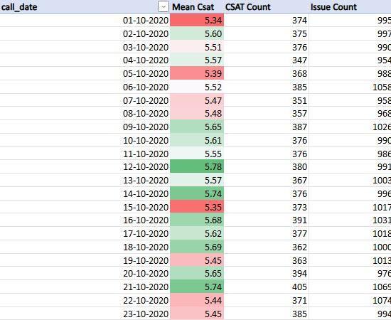
Hypothesis 4: Certain dates have a much higher number of reported issues, which affects CSAT scores.
Outcome - The analysis did not show any particular dates where a larger number of reported issues directly caused lower CSAT scores.
Analysis: The results showed that some days had a higher number of reported issues, but this didn’t always lead to lower CSAT scores. At the beginning and end of the month, the customer satisfaction (CSAT) scores were lower than in the middle of the month

Slide 13
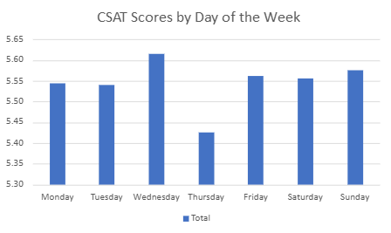
Hypothesis 4.1: The day of the week affects the customer satisfaction (CSAT) score
Outcome- The day of the week affects CSAT scores. Some days, like Thursday, might need more focus to keep customer satisfaction high.
Analysis: The results show that Wednesday had the highest average CSAT score, while Thursday had the lowest. This indicates that service demand and availability change during the week, which affects customer satisfaction.

Slide 14
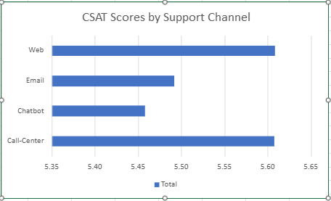
Hypothesis 5: Certain support channels (like phone, chat, or email) are better at solving issues, resulting in higher CSAT scores.
Outcome - The call center seems to be the best support channel for customer satisfaction. Encouraging its use or improving other channels could help increase overall CSAT scores.
Analysis: The results show that, after calculating the average (mean) CSAT score for each support channel, the call center and website had higher scores than email and chatbot. This suggests that customers may prefer or have better experiences with certain channels.

Slide 15
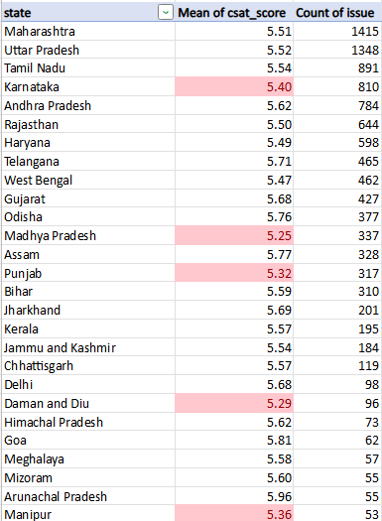
Hypothesis 6: Higher Issue Count Correlates with Lower Customer Satisfaction (CSAT) Scores Across Locations
Outcome: The hypothesis does not hold consistently across the data. Some regions with high issue counts still have moderate CSAT scores, while others with lower issue counts have low CSAT scores.
Analysis: The results show a weak negative correlation (-0.065) between issue count and mean CSAT score by location, suggesting only a slight tendency for higher issue counts to lower CSAT scores.

Slide 16
Key Findings
Location-Based Disparities in Customer Satisfaction: Kolkata's call center consistently shows lower CSAT scores than other locations, indicating potential location-specific issues impacting customer satisfaction.
High Impact of Billing-Related Issues on Satisfaction: Billing inquiries represent 72% of cases with CSAT scores ≤5, highlighting billing-related questions as a major factor driving customer dissatisfaction.
SLA Compliance Not Strongly Linked to Higher CSAT: Meeting Service Level Agreements (SLAs) does not show a significant impact on improving CSAT scores, suggesting that adherence to SLA alone may not enhance customer satisfaction meaningfully.
Day-of-Week Effects on Customer Satisfaction: CSAT scores vary by day, with Thursdays showing lower satisfaction levels, suggesting a potential need for additional resources or support on specific days to maintain consistent satisfaction levels.
Limited Influence of Response Times on Satisfaction: Contrary to expectations, response times do not exhibit a clear correlation with CSAT scores. The underperformance in CSAT scores in certain regions appears independent of response times.
Channel Performance Variation: The call center channel yields higher CSAT scores compared to other support channels, indicating its effectiveness in addressing customer issues and suggesting that improvements in other channels may be necessary to elevate overall CSAT.

Slide 17
Recommendations
Targeted Interventions for Low-Performing Locations: Focus on understanding and addressing specific challenges faced by underperforming locations like Kolkata, potentially through tailored training, resources, or process improvements.
Enhance Billing Support: Given the high dissatisfaction linked to billing inquiries, invest in targeted training for agents handling billing issues and consider proactive communication strategies to address common billing concerns.
Optimize Staffing Based on Day-of-Week Trends: Allocate additional resources or provide targeted support on days like Thursdays, when CSAT scores dip, to ensure consistent customer satisfaction throughout the week.
Leverage Strong Performance of Call Centers: Encourage use of the call center as the primary support channel while working to improve the quality and efficiency of other channels, such as chat and email, to provide a balanced customer service experience.

